Slide 1
Predicting Acute Renal Transplant Rejection with Machine Learning
Group 25
SAT 5114
Presented By: Naresh Rambhatla and Johnathan Oestringer

Slide 2
Introduction
Kidney transplant is life‑saving but acute rejection remains a key risk.
The body will see the new kidney as a foreign body and will attack it
Rejected kidneys can fail and can require a new kidney transplant to replace the old one
AI can help with Early identification of high‑risk patients can guide monitoring and therapy.

Slide 3
Problem Statement & Objective
Problem: Clinicians are not alway able to predict when a kidney transplant will be rejected. The data received has many factors that will be hard for a human to track at all times.
Project Goal: Predict acute kidney transplant rejection using patient and donor data.
Objective: Build an interpretable, efficient ML model to predict 1‑year acute rejection.

Slide 4

Literature Review
Key Findings from Prior Work:
HLA mismatches & high PRA strongly correlate with rejection risk (PLOS ONE, 2023).
Cold ischemia time and donor type (living vs. deceased) affect graft survival (BMC Nephrology, 2022).
Machine learning models (logistic regression, random forests) have shown AUCs ~0.70–0.85 in clinical datasets.
Gap: Few studies combine interpretability with efficiency suitable for real‑time clinical use.

Slide 5
Justification of Population
Data Source: OPTN STAR registry – national, multi‑center transplant data.
Inclusion Criteria: First kidney transplant, 1‑year follow‑up record available.
Rationale: Covers diverse demographics and transplant scenarios; results generalize broadly.

Slide 6
Data & Features
Outcome: Acute rejection within 1 year (binary).
Recipient Features: Age, sex, race/ethnicity, prior transplant, PRA (%), HLA mismatch count.
Donor Features: Age, sex, living vs deceased, DCD flag, history of HTN/diabetes, cold ischemia time.

Slide 7
Preprocessing Highlights
Imputed missing values with mean.
Stratified train/test split to preserve class balance.
One‑hot encoded race.

Slide 8
Code’s Purpose & Pipeline Overview
Pipeline Steps:
Purpose: Efficiently load, clean, engineer features, train models, and explain predictions.
Load & merge SAS datasets (follow‑up, transplant, donors)
Feature engineering: outcome flag, PRA, mismatches, flags
Imputation & encoding
Train & tune: Logistic Regression, Decision Tree, Random Forest (GridSearchCV)
Evaluate & explain: metrics, ROC, SHAP plots

Slide 9
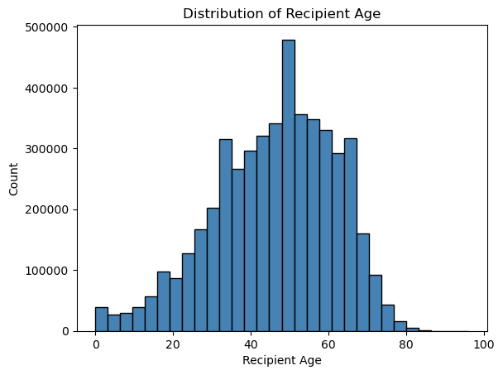
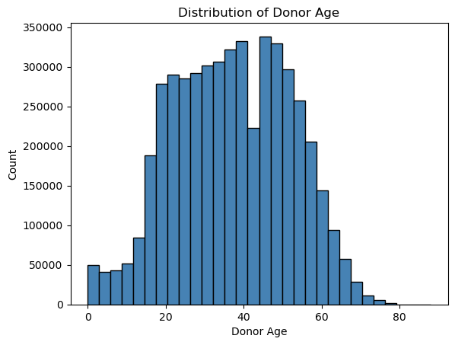
Feature Distributions

Slide 10
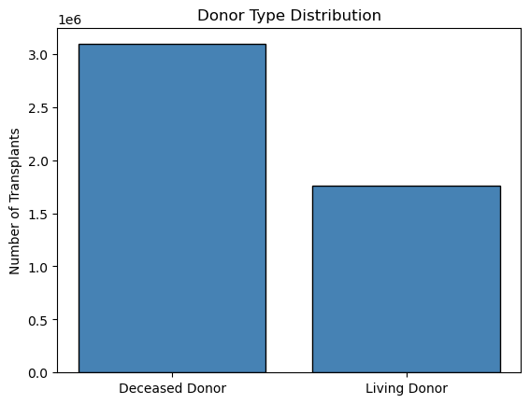
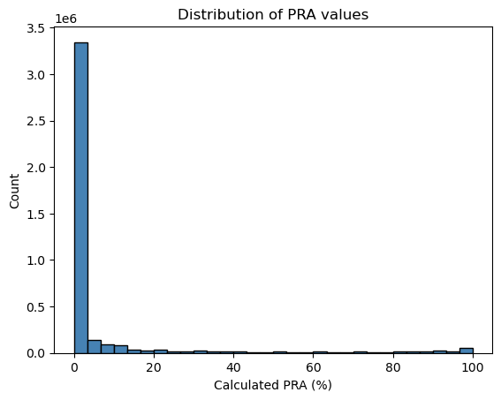
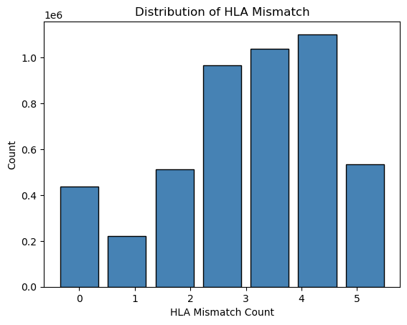
Feature Distribution

Slide 11
Model Performance Metrics
Model | AUC | Recall | Precision
Logistic Regression | 0.70 | 0.75 | 0.62
Decision Tree | 0.79 | 0.66 | 0.60
Random Forest (Tuned) | 0.79 | 0.62 | 0.65

Slide 12
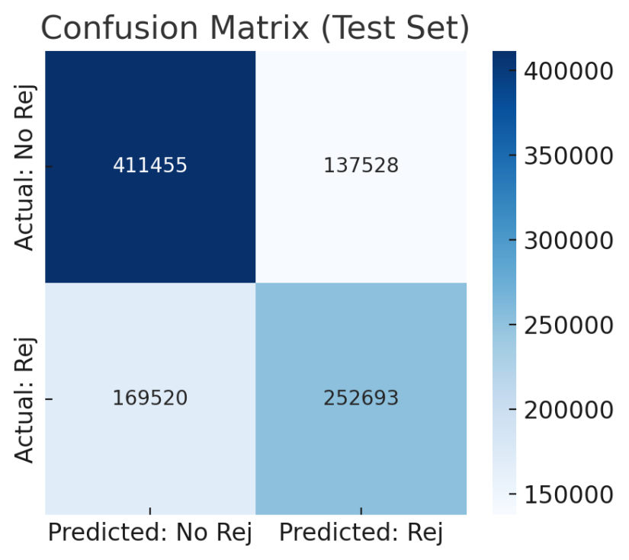
Confusion Matrix
Confusion Matrix (RF): shows true/false positives & negatives

Slide 13
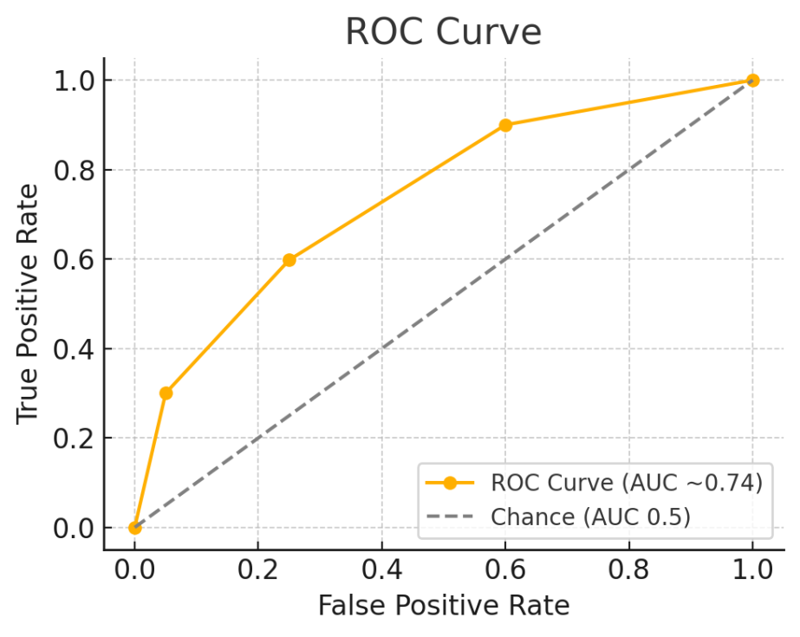
ROC Curve
ROC Curve (RF): AUC 0.75, demonstrates sensitivity/specificity trade‑off

Slide 14
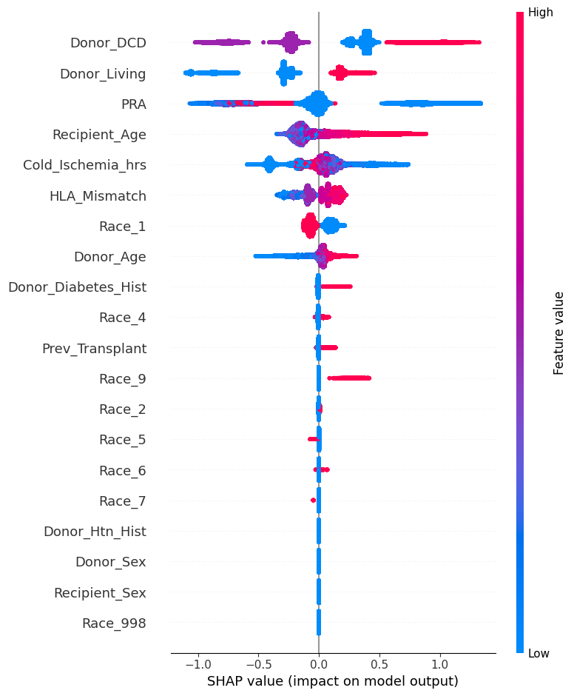
Feature Importance & SHAP
Top Predictors: HLA mismatch, PRA, cold ischemia, donor type
SHAP Summary Plot: Visualizes each feature’s impact on rejection risk
Interpretation: High PRA and mismatches push risk ↑; living donor pushes risk ↓

Slide 15
Logic of Findings & Clinical Implications
Logical Flow:
Known immunological factors (PRA, HLA) emerged as top predictors—validates model.
Data‑driven discovery: cold ischemia time also influential.
Clinical Impact:
Risk score at discharge → personalized follow‑up intensity.
Explainable alerts (with SHAP) build clinician trust.

Slide 16
References
• Yadav, A. “SHAP Values for Random Forest.” Medium. Explains that SHAP values attribute how each feature impacts the model’s prediction (driving it higher or lower) medium.com.
• Encord Blog. “Precision-Recall Trade-Off in Imbalanced Datasets.” Emphasizes that in imbalanced data, accuracy can be misleading and one should consider precision, recall, and their trade-off encord.com.
• OPTN Data Dictionary: Reference for dataset fields (e.g. ACUTE_REJ_EPI, PRA, HLAMIS definitions).
• Stojiljković, M. “Split Your Dataset With scikit-learn’s train_test_split().” Real Python. Notes the use of stratify to maintain class distribution in train/test splits realpython.com.
Monnet et al. “Should AI models be explainable to clinicians?” Critical Care (2024). Discusses that explainable AI (XAI) enhances clinician confidence and meets transparency requirements pmc.ncbi.nlm.nih.gov.

Slide 17
References Page 2
• Sharma, V. “Handling Imbalanced Data to Improve Precision.” Highlights techniques like SMOTE for dealing with class imbalance keylabs.ai.
• Deepagohila. “EDA on Healthcare Dataset.” Medium. Underlines the importance of data cleaning, handling missing values, and visualizing distributions to uncover patterns medium.com medium.com.
• Keylabs. “Logistic Regression: Overview and Applications.” Notes that a key benefit of logistic regression is the interpretability of its coefficients, especially valuable in healthcare contexts keylabs.ai.
• PLOS ONE. “Pretransplant identification of acute rejection risk.” Reports that higher HLA mismatch is a well-established risk factor for acute rejection, with significant hazard ratios onlinelibrary.wiley.com.
• BMC Nephrology. “Peak PRA and acute rejection.” Finds that kidney recipients with peak PRA > 80% had ~1.8-fold higher odds of acute rejection, underscoring PRA as a risk predictor pubmed.ncbi.nlm.nih.gov.

Slide 18
Acknowledgments
In conclusion, we’ve tried to built an interpretable, resource‑light ML pipeline that accurately flags high‑risk transplant patients. By integrating SHAP explanations, we ensure clinicians understand why a particular patient is at risk. This tool can support personalized monitoring and therapy adjustments to improve graft outcomes!

